Slide 1
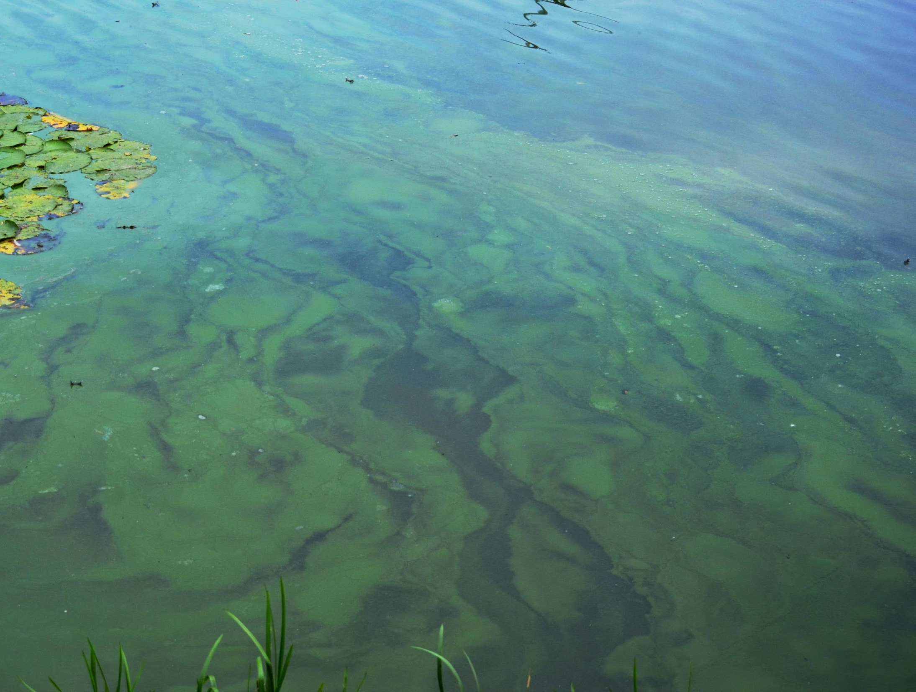

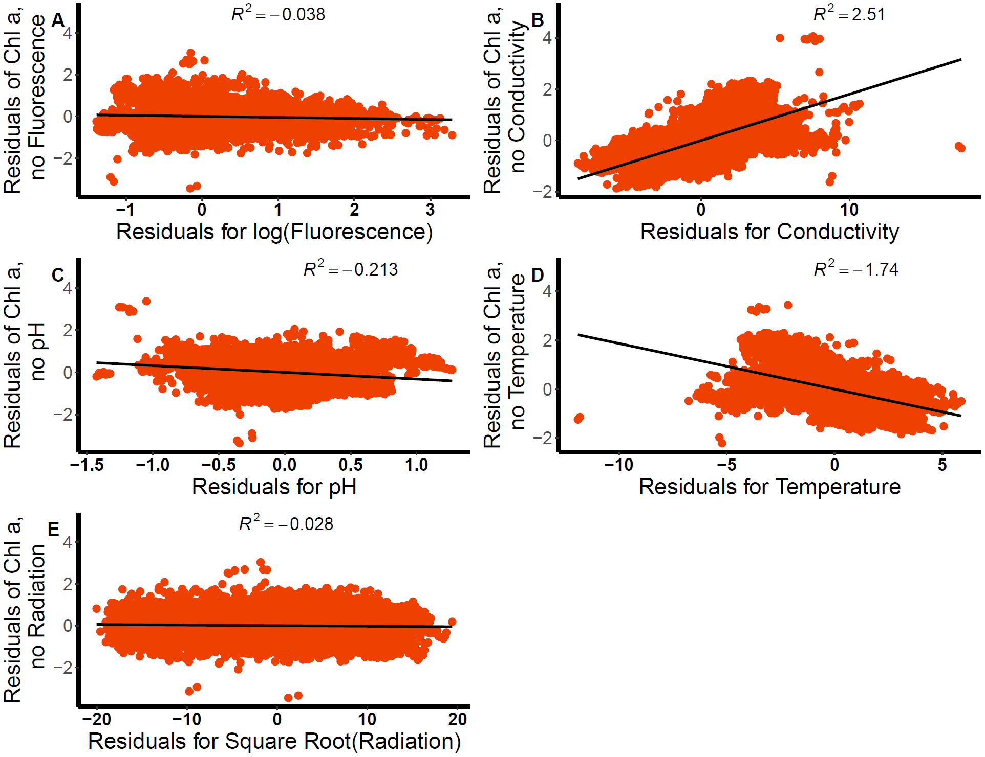
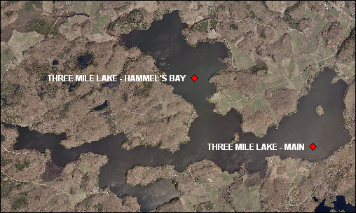
Environmental predictors of algal blooms in a freshwater lake in Ontario, Canada Academia Blooms: Meg Britt, Eric Massa, Kristen Hayward, & Meghan Hamp
BACKGROUND
Climate change and human pollution are contributing to
an increase in frequency and severity of algal blooms.
In freshwater systems, algal blooms negatively impact
water quality and ecosystem functioning, which has
health, recreational, and economic implications.¹
Thus, identification of key environmental predictors of
algal blooms is becoming increasingly important.
Traditional algal bloom prediction methods are aimed at
marine environments and rely on time- and labor-
intensive methods that are not feasible for scales finer
than 30 km².²
However, monitoring chlorophyll fluorescence has been
suggested as a cost-effective, early warning mechanism
for algal blooms in freshwater systems.
Previous studies have highlighted the importance of
other environmental variables, such as temperature, in
predicting blooms.³
Objectives:
(1) Assess the relationship of chlorophyll a content
(proxy for bloom biomass) with chlorophyll
fluorescence & multiple environmental conditions.
(2) Examine whether the rate of
change in chlorophyll
fluorescence can be used to
predict algal blooms, as
indicated by chlorophyll.
METHODS PIPELINE
DISCUSSION
Objective 1: Our results indicate that several environmental variables are significantly associated with algal bloom presence at Three Mile Lake. Water conductivity and temperature were the two most closely related variables to bloom presence, which is consistent with previous research in freshwater systems. Water temperature in particular has been shown to affect water density and stratification periods in ways that are beneficial to certain species of cyanobacteria⁴.
Objective 2: As predicted, chlorophyll a content and fluorescence were associated. However, plotting of these variables on a temporal scale showed that chlorophyll a content peaks before fluorescence, which contrasts previous findings that fluorescence peaks first. This suggests that we cannot use fluorescence as an indicator for blooms. However, the present study uses total fluorescence, whereas several studies with positive findings use species-specific wavelengths instead of the total value. These studies have also used data collected over multiple years to assess temporal patterns³. Thus, the present study may not have a sufficient time scale or appropriate fine-scale measures to discern this relationship.
Implications Despite not finding the predicted temporal relationship between chlorophyll a content and fluorescence, our results provide insight into environmental variables that can act as important predictors for blooms. These insights may aid in establishing a reliable and efficient early warning system for algal blooms in eutrophic freshwater ecosystems.
RESULTS: BLOOM PREDICTORS
Three Mile Lake
METHODS
Dataset
Sampling conducted to create data set occurred at Three Mile Lake in Muskoka, Ontario: a 8.8 km² freshwater lake, shoreline perimeter of 31.2 km, surrounded by lakefront cottages
Contains 10-minute averages of continuously measured
environmental variables (25,000 measurements) from
May 31 to December 19, 2018
Subsetted to include the following variables:
CONCLUSIONS & NEXT STEPS
Conductivity & water temperature were most closely
related to bloom presence.
Future research will be needed to clarify the relationship
between fluorescence and algal bloom onset.
To improve understanding of bloom causal mechanisms,
future studies may:
Objective 1
Figure 1. Added variable plots showing the relation between chlorophyll a (chl a) content and (A) chl. a fluorescence, (B) water conductivity, (C) water pH, (D) water temperature, & (E) light radiation.
Monitor community dynamics and rate processes over several years
Investigate other key environmental variables (e.g. nutrient concentrations)
water temperature (0.1m below surface)
conductivity
longwave radiation (available sunlight at surface)
pH
fluorescence (relative chlorophyll fluorescence)
chlorophyll a (proxy for algal biomass)
Figure 2. Time series of chl. a content and fluorescence at Three Mile Lake between May 31-Decmeber 19,2018.
Objective 2
REFERENCES
1. Paerl, H.W., & Otten, T.G. (2013). Harmful cyanobacterial blooms: causes, consequences and
controls. Microbial Ecology. 65: 995–1010.
2. NOAA. Historical Maps and Charts audio podcast. National Ocean Service website, https://oceanservice.noaa.gov/podcast/july17/nop08-historical-maps-charts.html, accessed on 8/13/17.
3. Wang, H., Zhu, R., Zhang, J., Ni, L., Shen, H., & Xie, P. (2018). A novel and convenient method for early warning of algal cell density by chlorophyll fluorescence parameters and its application in a highland lake. Frontiers in Plant Science, 9(June), 1–13. https://doi.org/10.3389/fpls.2018.00869
4. Barros, M. U. G., Wilson, A. E., Leitão, J. I. R., Pereira, S. P., Buley, R. P., Fernandez-Figueroa, E. G., & Capelo-Neto, J. (2019). Environmental factors associated with toxic cyanobacterial blooms across 20 drinking water reservoirs in a semi-arid region of Brazil. Harmful Algae, 86(May), 128–137. https://doi.org/10.1016/j.hal.2019.05.006

